Slide 1



First Review
An Uncertainty-Aware Active Learning Framework for Sentiment Analysis Using Transformer Based Models
Batch N0:259
Presented By:
221FA04625 M.Shanmukha Priya
221FA04700 K.Swathi
Guide details:
Mrs . S. Anitha
Asst.Prof
Dept of CSE

Slide 2


Agenda Overview
01
Introduction
02
Motivation
03
Dataset Description
04
Proposed Models
05
Identification of Tools / Equipment / Training Needs
06
Methodology
07
Literature Survey

Slide 3

Introduction
Sentiment analysis is a key task in Natural Language Processing (NLP) that involves determining the emotional tone expressed in text.
It is widely used in fields such as social media monitoring, customer feedback analysis, and market research to extract opinions and attitudes from written language.
Sentiment analysis helps identify whether the sentiment in a piece of text is positive, negative, or neutral.
Problem Statement
Existing sentiment analysis models require large labeled datasets and often fail to correctly understand contextual and implicit sentiments in text. Manual labeling of large datasets like IMDB reviews is time-consuming and costly. This project aims to improve sentiment classification accuracy while reducing labeling effort using an uncertainty-aware active learning approach with Transformer-based models.

Slide 4
Motivation
Traditional sentiment analysis methods struggle to capture implicit sentiments, relying heavily on explicit sentiment words, which leads to poor text representations and misinterpretations in complex scenarios.
Additionally, these models fail to address contextual and cultural factors that influence sentiment expression, resulting in suboptimal performance on diverse datasets.
To overcome these limitations, there is a need for context-aware models.
This motivates the exploration of hybrid deep learning approaches, which offer the potential to model complex relationships, implicit cues, and cultural nuances, leading to more accurate sentiment analysis.

Slide 5
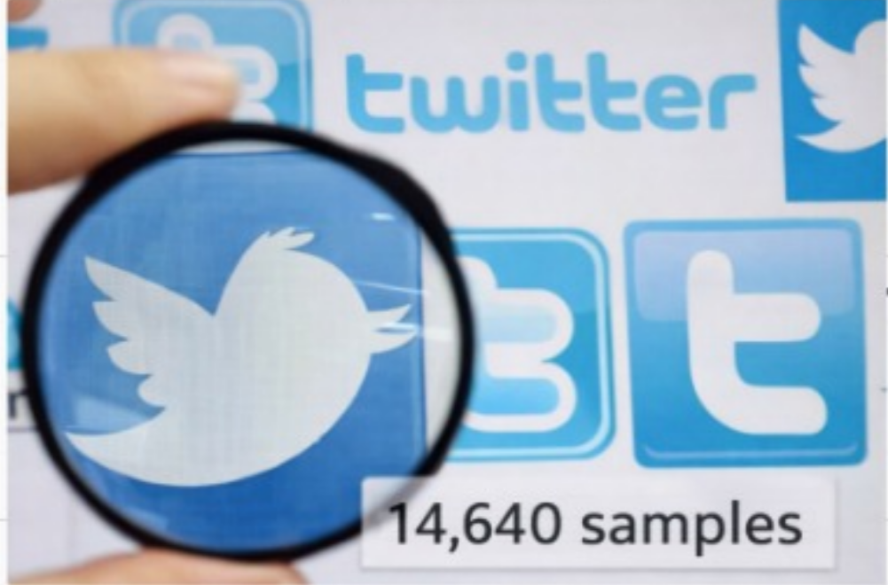
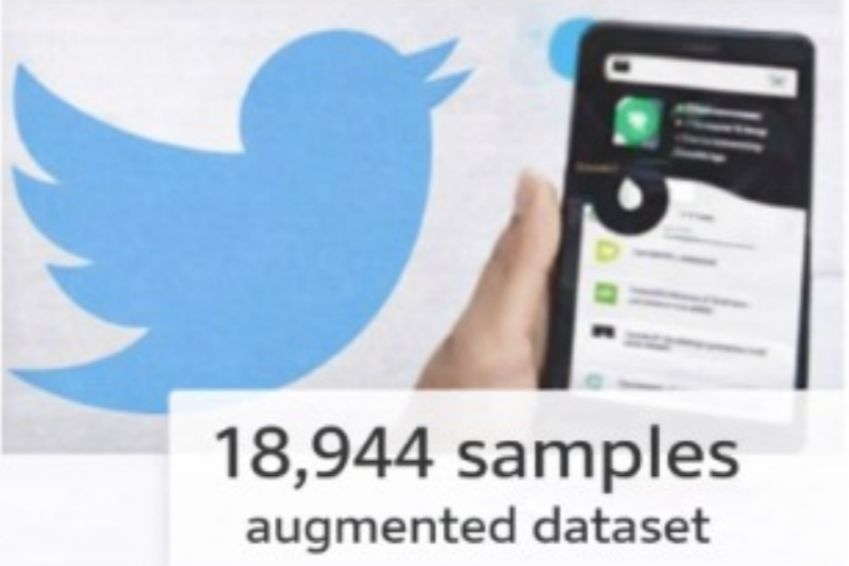
Dataset Description
Dataset Name: IMDB Movie Reviews Total Reviews: 50,000 (Balanced - 25,000 Positive & 25,000 Negative) Text Format: Raw movie reviews from IMDB Labels: Positive (1) & Negative (0) Use Case: Sentiment classification for understanding audience opinions
GitHub Repository
https://github.com/Shannu1695/Final-Year-Project

Slide 6

Proposed Model
BERT (Bidirectional Encoder Representations from Transformers) – Main model for sentiment classification; captures contextual meaning of text.
DistilBERT – Lightweight and faster version of BERT used for efficient training.
RoBERTa – An optimized Transformer model that improves sentiment prediction accuracy.
Baseline Machine Learning Model (Logistic Regression / SVM) – Used for performance comparison.

Slide 7

Identification of Tools / Equipment / Training Needs
Tools / Software
Programming Language: Python
Development Environment:Google Colab
Libraries Used:
NumPy, Pandas – data handling
Scikit-learn – preprocessing and evaluation
PyTorch / TensorFlow – deep learning framework
HuggingFace Transformers – BERT, DistilBERT, RoBERTa models
Matplotlib / Seaborn – result visualization
Hardware / Equipment
Laptop / Desktop Computer
Minimum 8 GB RAM (recommended for smooth execution)
GPU support (Google Colab / CUDA) for faster transformer training

Slide 8


Training / Knowledge Requirements
Basics of Python programming
Understanding of Natural Language Processing (NLP)
Knowledge of Transformer architectures (BERT, RoBERTa, DistilBERT)
Familiarity with active learning concepts
Model evaluation metrics: Accuracy, Precision, Recall, F1-Score
Hardware / Equipment
Laptop / Desktop Computer
Minimum 8 GB RAM (recommended for smooth execution)
GPU support (Google Colab / CUDA) for faster transformer training

Slide 9
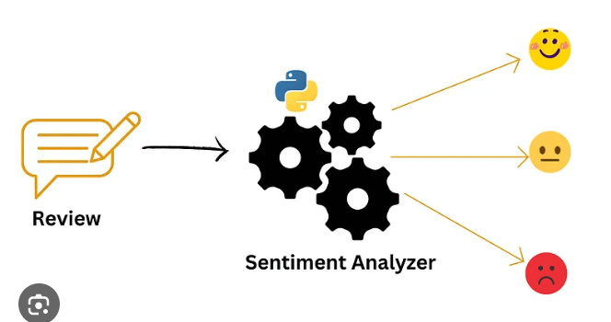
Finalized Basic Methodology
Dataset Collection: Use publicly available sentiment datasets such as IMDB movie reviews or Twitter text datasets.
Data Preprocessing: Clean the text by removing noise, stop words, URLs, and special characters, followed by tokenization suitable for transformer models.
Baseline Model Training: Train traditional machine learning models (Logistic Regression / SVM) using features like TF-IDF to establish baseline performance.
Transformer Model Training: Fine-tune transformer-based models (BERT, DistilBERT, RoBERTa) on a small labeled dataset to capture contextual sentiment information.

Slide 10
Dataset Collection: Use publicly available sentiment datasets such as IMDB movie reviews or Twitter text datasets.
Data Preprocessing: Clean the text by removing noise, stop words, URLs, and special characters, followed by tokenization suitable for transformer models.
Baseline Model Training:
T
Uncertainty Estimation: Identify samples with low confidence predictions from the unlabeled data pool using model uncertainty measures.
Active Learning Loop: Select the most uncertain samples, label them, and add them to the training set for iterative retraining.
Model Evaluation: Evaluate all models using accuracy, precision, recall, and F1-score to analyze performance improvement.
Final Model Selection: Select the best-performing model as the final sentiment analysis system.

Slide 11
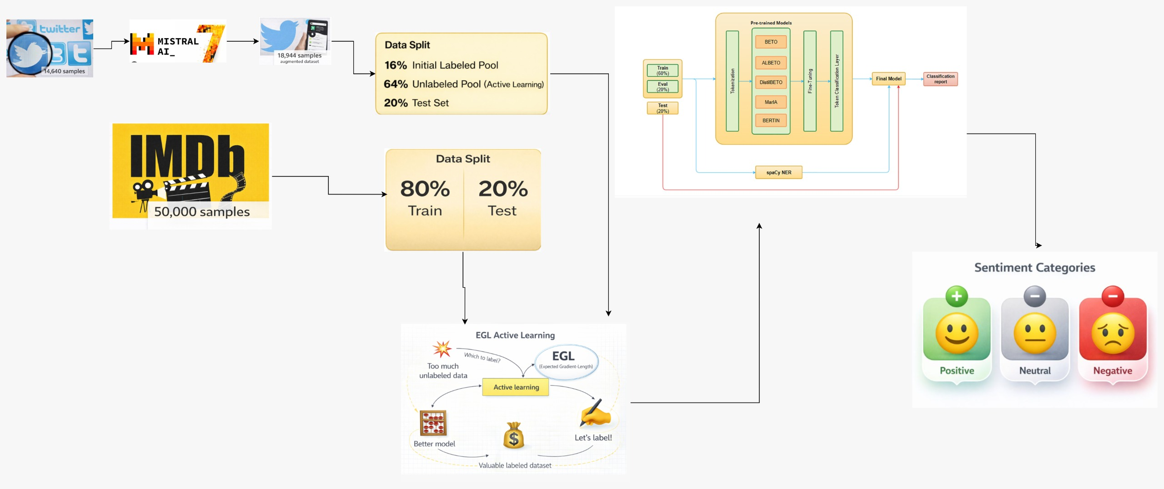
Proposed System Architecture

Slide 12
Literature Survey
S.No | Authors & Year | Title | Methods Used | Advantages | Limitations | Publication
1 | Afzal (2024) | Transformer-based active learning for multi-class text classification | BERT, Active Learning | Reduces labeling cost, improves accuracy | High computation cost | Digital Health
2 | Kumar et al. (2025) | SentXFormer: Hybrid transformer framework | BERT + CNN/GRU | Better cross-domain performance | Complex architecture | Scientific Reports
3 | El Azzouzy & Berrada (2025) | Transformer models for YouTube sentiment | BERT, RoBERTa | High accuracy on social media text | Limited to YouTube data | Journal of Information Processing
4 | Pookduang (2025) | RoBERTa performance evaluation | RoBERTa, DL models | Strong contextual understanding | Requires large datasets | ETASR
5 | Jakha et al. (2025) | Multilingual sentiment analysis | Multilingual BERT | Supports multiple languages | Lower accuracy for low-resource languages | Entropy
6 | Albladi et al. (2025) | Hybrid transformer framework | Ensemble Transformers | Improved robustness | High training time | arXiv
7 | Mehta & Verma (2026) | DL vs Transformer comparison | CNN, LSTM, BERT | Clear performance comparison | Dataset-dependent results | IJDSA
8 | Wang & Chen (2024) | Context-aware sentiment analysis | Fine-tuned BERT | Better contextual understanding | Fine-tuning is expensive | IEEE Access
9 | Rahman et al. (2024) | Uncertainty-based active learning | BERT + Uncertainty Sampling | Efficient sample selection | Needs careful threshold tuning | Expert Systems with Applications
10 | Singh & Kaur (2025) | Aspect-based sentiment analysis | Transformer Attention | Captures aspect-level sentiment | Complex annotation process | Applied AI

Slide 13
S.No | Authors & Year | Title | Methods Used | Advantages | Limitations | Publication
11 | Zhang et al. (2025) | Domain-adaptive sentiment analysis | Domain-adaptive BERT | Works well across domains | Domain shift still challenging | Knowledge-Based Systems
12 | Kumar & Patel (2024) | Lightweight transformer models | DistilBERT | Faster and memory-efficient | Slight accuracy drop | Neural Computing & Applications
13 | Hassan & Alotaibi (2024) | Active learning strategies | ML + Active Learning | Reduces annotation effort | Depends on sampling strategy | IP&M
14 | Park & Lee (2025) | Social media sentiment analysis | RoBERTa, DistilBERT | High accuracy on tweets | Noise in social data | Journal of Big Data
15 | Ali et al. (2025) | Low-resource language sentiment | Transformer models | Supports low-resource languages | Limited datasets available | ACM TALLIP
16 | Zhou & Wang (2024) | Graph-enhanced transformers | Graph Transformer | Better relationship modeling | High computational complexity | PRL
17 | Patel & Shah (2025) | Uncertainty-aware transformers | BERT + Uncertainty | Improved decision confidence | Implementation complexity | AI Review
18 | Ahmed et al. (2026) | Ensemble transformer sentiment analysis | Ensemble BERT models | High accuracy and stability | Very high computation | FGCS
19 | Verma & Joshi (2024) | Cross-lingual sentiment analysis | Multilingual BERT | Cross-language support | Translation errors | Natural Language Engineering
20 | Brown & Miller (2026) | Large-scale sentiment evaluation | Modern Transformers | Scales to large datasets | Infrastructure dependent | IEEE TCSS

Slide 14
Conclusion
Sentiment analysis helps find emotions in text, making it helpful for businesses, social media, and customer support. Using different methods makes it more accurate and better at understanding feelings. Advanced techniques make it more reliable and useful in real life. In the future, it can get better at understanding sarcasm, slang, and different languages.

Slide 15
THANK YOU…

